Slide 1

CAPSTONE PROJECT Patient Disabilities: Machine learning for Crime rates
SUBMITTED BY:
KOMAL(0891433)
KEYUR(0805748)
ABHISHEK(0803640)
SUBMITTED TO:
SAVITA SEHRAWAT

Slide 2

CONTENT
Introduction of crime rate
Objectives & Regarding the dataset
Data importing and data cleaning
Libraries and EDA
Normalization & min max scaler
Model implementation & evaluation
Summary

Slide 3

Crime rate Analysis
This study examines the trends in crime rate from the year 2001 to the present day, aiming to shed light on the evolving patterns of criminal activities over the past two decades.
The primary objective is to analyze and interpret the data to gain insights into the fluctuations and long-term changes in criminal incidents during this period. The data utilized in this research comprise official crime statistics collected from various law enforcement agencies and relevant government sources.
The study adopts a quantitative approach, employing statistical methods and data visualization techniques to explore the crime rate trends across different categories of offenses, such as violent crimes, property crimes, and white-collar crimes.
The findings of this study reveal notable shifts in crime rates over the years, highlighting significant variations in crime patterns across regions and crime types. By examining the factors that might have contributed to these changes, this study aims to provide a deeper understanding of the complexities surrounding crime dynamics.

Slide 4

Objectives
In this project we are looking to analyze the different disabilities estimates. We would find the growing field that utilizes advanced data analytics and machine learning techniques to extract valuable insights from the crime’s data and enhance public security

Slide 5

Regarding the dataset
The dataset is about Crime rates
This dataset gives details of all crime rate. The dataset used in this study encompasses crime rate statistics for a specific geographical area, covering the period from 2001 to the present. The data is sourced from reliable law enforcement and government databases and is structured to include information on different types of crimes, geographical locations, and timestamps.
Reference link:

Slide 6
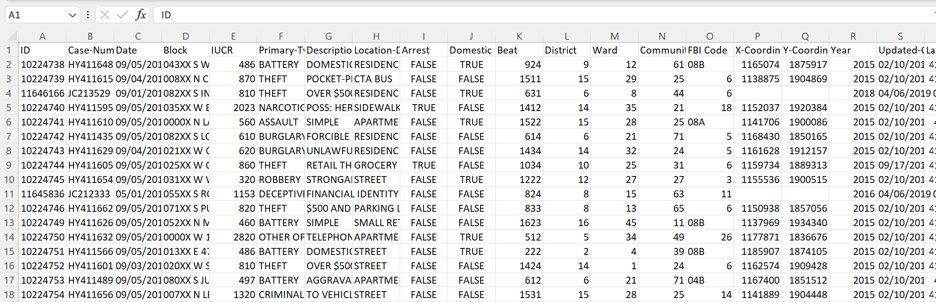
DATASET

Slide 7

IMPORTING THE DATA

Slide 8
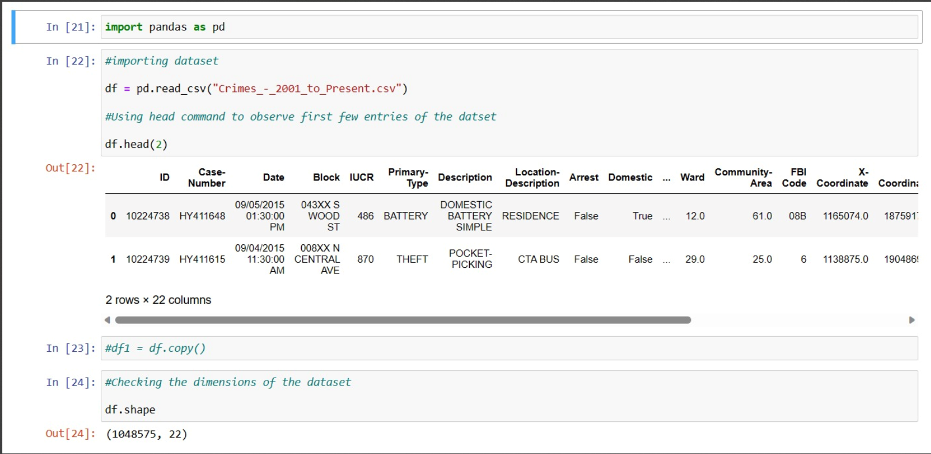

Slide 9

METHODOLOGY

Slide 10
METHODOLOGY
This research focuses on utilizing Exploratory Data Analysis (EDA) and Data Modeling techniques to process and analyze crime rate data from the year 2001 to the present. The primary objective is to gain insights into the temporal patterns and underlying factors influencing crime rates over the years, ultimately enabling better-informed decision-making for crime prevention and public safety strategies.

Slide 11

DATA PREPROCESSING
Data preprocessing is a crucial step in the data analysis and machine learning workflow. It involves transforming raw data into a format suitable for analysis or modeling, ensuring that the 8 data is accurate, consistent, and ready for further processing. Proper data preprocessing can significantly impact the performance and accuracy of machine learning models

Slide 12

Exploratory Data Analysis (EDA)
:The EDA phase involves comprehensive data exploration to uncover patterns, trends, and potential anomalies. Descriptive statistics, data visualization, and other EDA techniques will be employed to identify the distribution of crime rates across time, regions, and crime categories. The EDA process will also examine relationships between crime rates and various socio-economic variables, such as population density, unemployment rates, and education levels

Slide 13

DATA MODELING
For data modeling, advanced statistical and machine learning algorithms will be applied to develop predictive models. Time series analysis will be employed to forecast future crime rates 5 based on historical patterns, enabling the identification of potential hotspots and proactive allocation of resources. Additionally, machine learning models, such as regression, decision trees, and clustering, will be utilized to uncover hidden patterns and correlations within the data, offering valuable insights for crime prevention strategies

Slide 14
DATA CLEANING
It involves preparing the collected data for analysis by removing any irrelevant information. i.e.
Removing irrelevant data.
Removing duplicates.
Removing special characters.

Slide 15
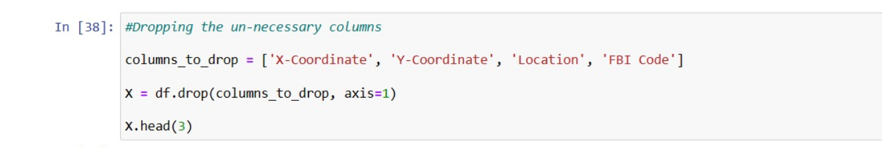

Slide 16
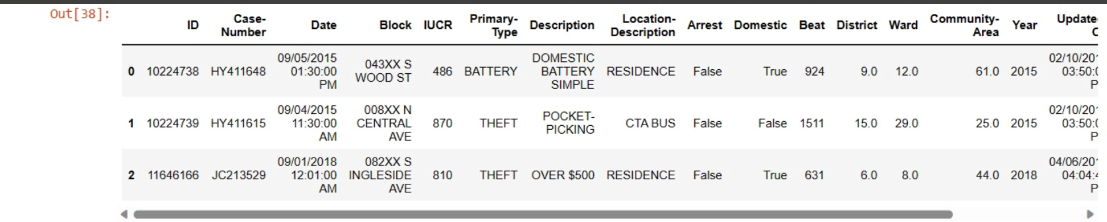

Slide 17
Libraries that are used
Pandas
NumPy
Matplotlib
Seaborn

Slide 18
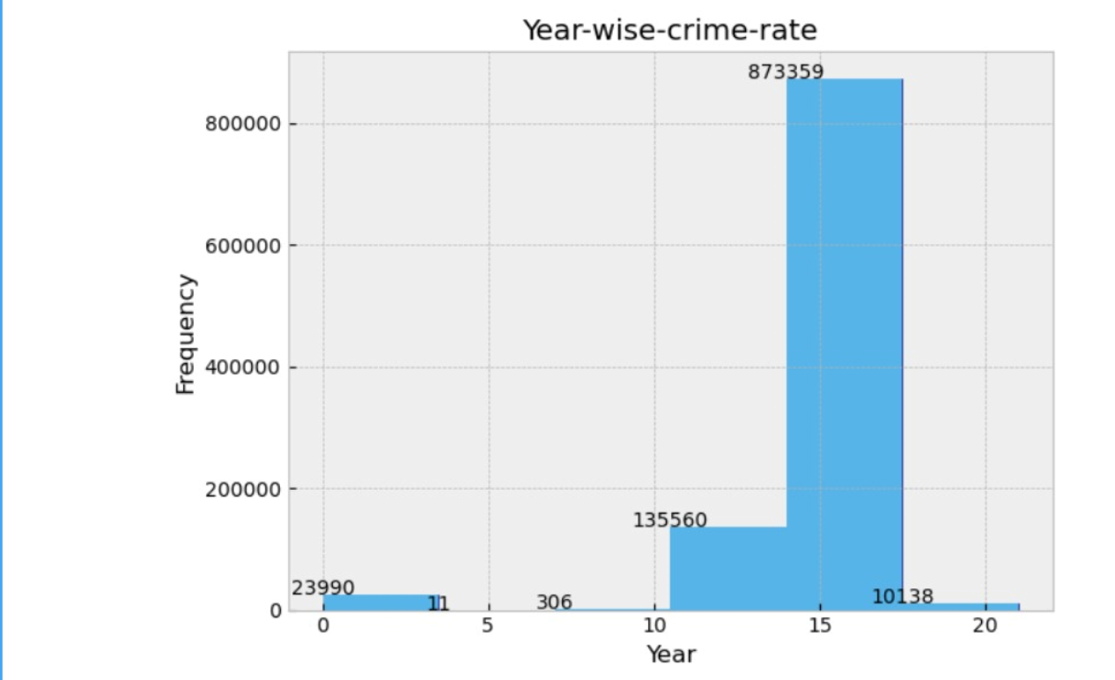
GRAPHICAL REPRESENTATION

Slide 19
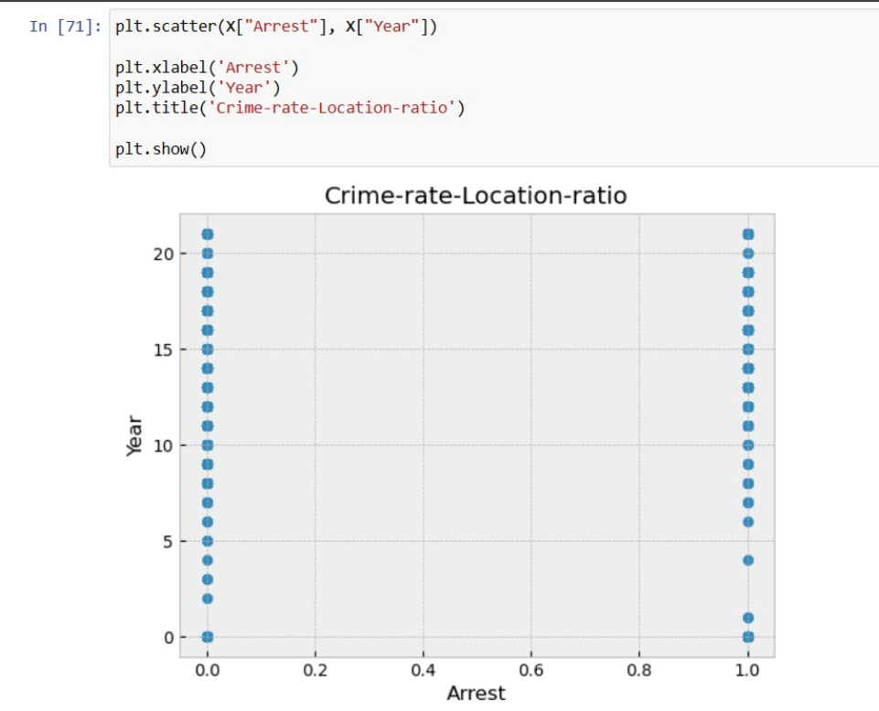

Slide 20
NORMALIZATION
It is used to describe the process of standardizing or sealing data to bring it into a consistent range or distribution. It is a common technique used in various fields, including statistics, data analysis, machine learning and database management. The main goal of normalization is to eliminate or reduce data redundancy and improve data integrity.

Slide 21

MINI- MAX SCALER
It is used to scale numerical features to a specific range, typically between 0 and 1. It means that minimum value of the feature to 0 and the maximum value to 1, and all other data points are scaled proportionally between 0 and 1. It is used in machine learning and data analysis to transform numerical features in a dataset.
Mini-Max scaling is also known as mini-max normalization.

Slide 22

MODELS IMPLEMENTATION AND EVALUATION

Slide 23

K-NN (k-nearest Neighbors)
KNN is a machine learning algorithm that's used for classification and regression. It's based on the idea of feature similarity. It's a non-parametric and lazy learning algorithm, which means that it doesn't make any assumptions about the underlying distribution of the data and only learns from the training examples when it's needed. The KNN algorithm works by finding the K nearest neighbors to a given data point and then using their labels to predict the label of the new data point. The value of K is chosen by the user and determines the number of neighbors that are used to make the prediction. The KNN algorithm is simple to implement and can be used for both classification and regression tasks.

Slide 24

DECISION TREE
Decision tree is a machine learning algorithm used for classification and regression. It's a tree-like model where each node represents a feature or attribute, and each branch represents a decision or a rule. The algorithm works by recursively splitting the data based on the most significant feature, creating a tree-like structure. The goal is to create a tree that's as small as possible while still accurately predicting the outcome. Decision trees are easy to understand and interpret, making them useful for decision-making tasks. They can handle both categorical and numerical data, and they can be used for both binary and multi-class classification tasks.Decision trees can be used for both supervised and unsupervised learning tasks. In supervised learning, the algorithm learns from labeled data, while in unsupervised learning, the algorithm learns from unlabeled data. Decision trees can also be used for feature selection, where the most important features are selected based on their ability to split the data and improve the accuracy of the model.One of the advantages of decision trees is that they can handle both continuous and discrete data, making them useful for a wide range of applications. They're also easy to interpret and explain, making them useful for decision-making tasks. However, decision trees can be prone to overfitting, where the model is too complex and fits the training data too closely, which can lead to poor generalization performance on new data. To avoid overfitting, techniques like pruning and regularization can be used to simplify the model and improve its generalization performance.

Slide 25
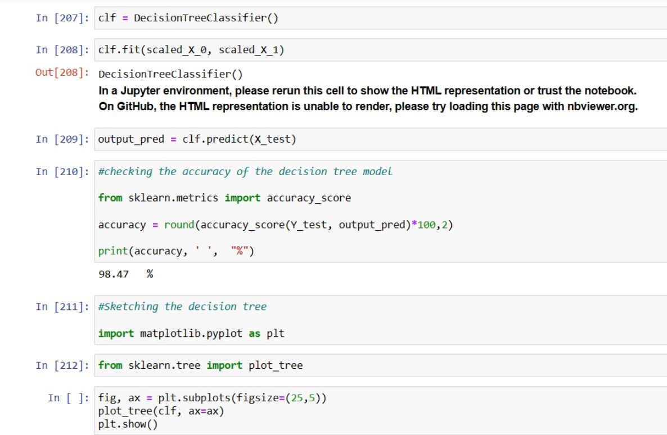

Slide 26

CONCLUSION
Overall, the integration of EDA and Data Modeling in the analysis of crime rate data has proven to be a powerful approach in understanding the complexities of criminal activities. The findings of this research provide valuable knowledge for developing evidence-based strategies, allocating resources efficiently, and fostering community-oriented approaches to crime prevention. While this study contributes to our understanding of crime trends in the specified region, it is essential to acknowledge the limitations of the data and the models used. As with any data analysis, the accuracy and effectiveness of the conclusions are contingent on data quality and the selected modeling techniques

Slide 27
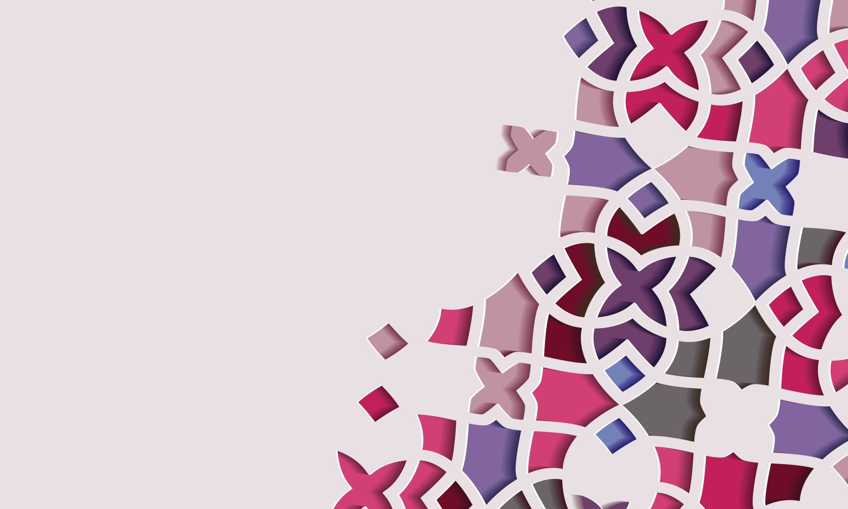
THANKYOU

